Slide 1
Analysis of B₁-sensitivity of qMT parameters when using two different T1 methods
Mathieu Boudreau
MRIL Lab Meeting
September 29th 2014

Slide 2
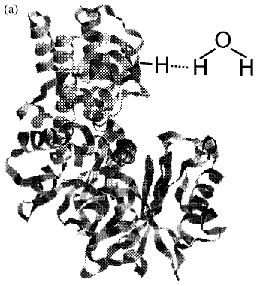
Hydrogen in myelin can’t be directly measure with MRI

Slide 3
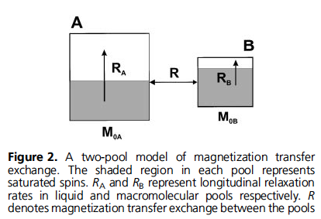
2-Pool Magnetization Transfer Model

Slide 4
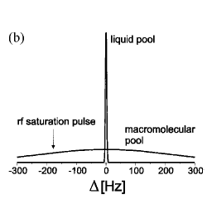
Prepare magnetization using off-resonance saturation

Slide 5
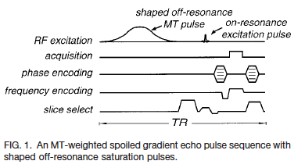

Slide 6
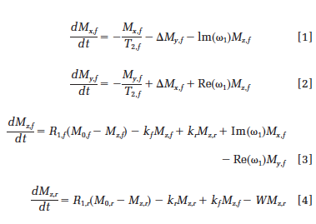
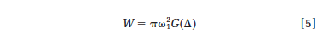
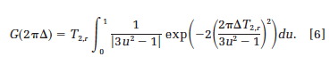
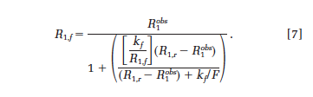

Slide 7
5 Fitted parameters
F – pool size ratio (correlates with myelin density)
kf – Magnetization transfer exchange rate
T2r – T2 of restricted pool
T2F – T2 of free pool
T1F – T1 of free pool
(T1R always set to 1, model not sensitive to this parameter)
qMT processing code: www.github.com/sharktank-bic/qMTLab/

Slide 8
Measurements
11 qMT measurements
1 MT off
10 MT point design (e.g. UK,2 MT angles, 5 logarithmic off-resonance frequencies)
B0 – For off resonance frequency correction
B1 – For MT and excitation pulse correction
T1 – Additional measurement to further constrain the MT mathematical model

Slide 9
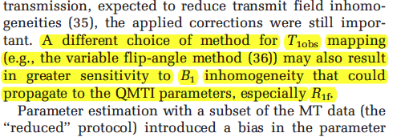
Measurements
But T1 measurements can depend on B1
B1 independent
Inversion recovery
Look-Locker (can be)
B1 dependent
Variable Flip Angle/DESPOT1
Levesque I., MRM, 2010

Slide 10
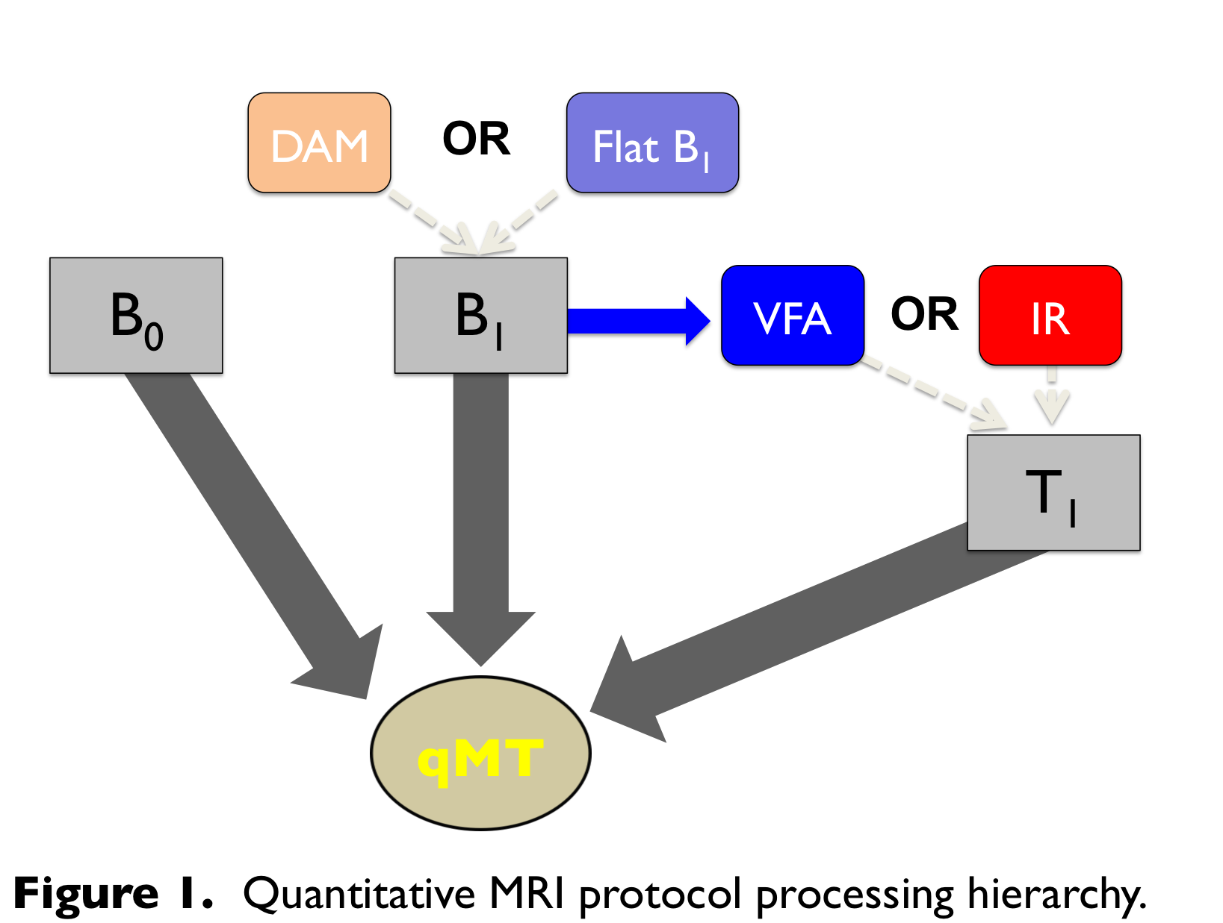
B₁ error propagation pathways

Slide 11
Questions
How do qMT fitted parameter (F, kf) behave when B1 errors occur when using:
IR: B1 independent T1 method
VFA: B1 dependent T1 method
Does this relationship hold in vivo (noise, range of tissue MR parameters, etc.)
Does it hold for abnormal tissue parameters (e.g. MS lesions).

Slide 12
Stage 1: Simulations
UK qMT protocol
Healthy WM tissue parameter
True T1 = 900 ms
True B1 = 1 (n.u.).

Slide 13
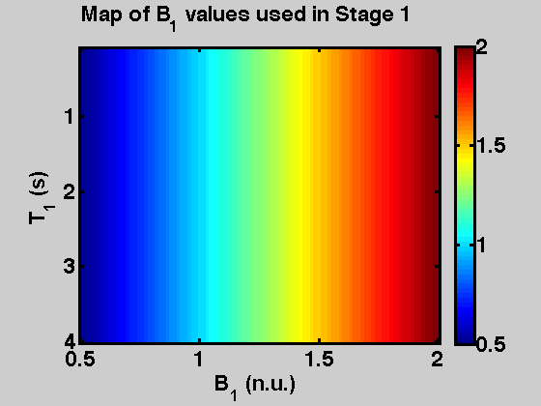

Slide 14
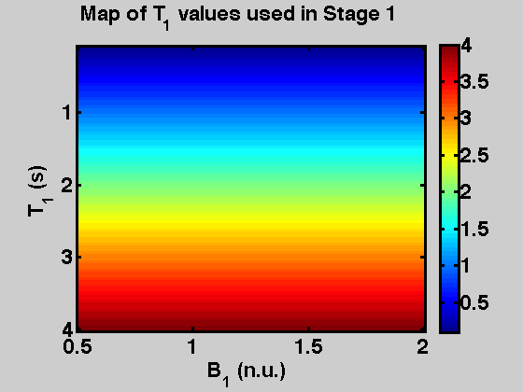

Slide 15
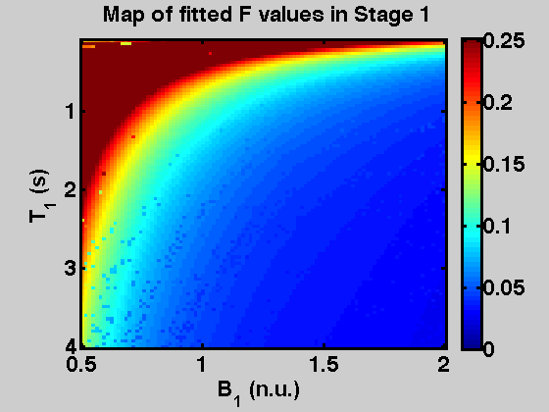

Slide 16
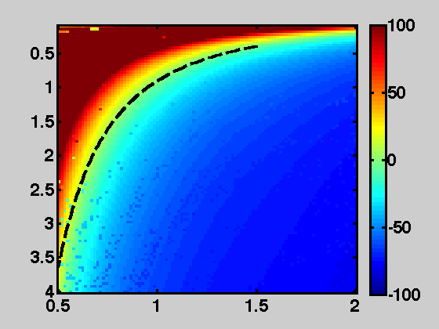
Fitted qMT F error %
T₁ (s) error (true value 0.9)
B₁ error (n.u.)

Slide 17
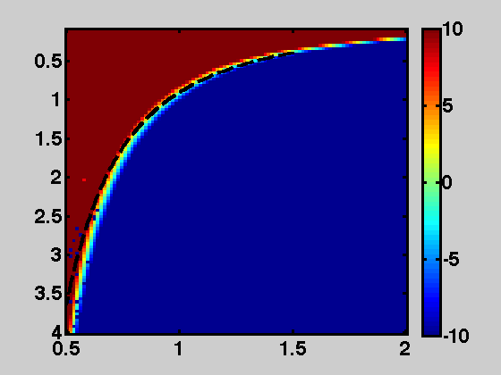
Fitted qMT F error %
T₁ (s) error (true value 0.9)
B₁ error

Slide 18
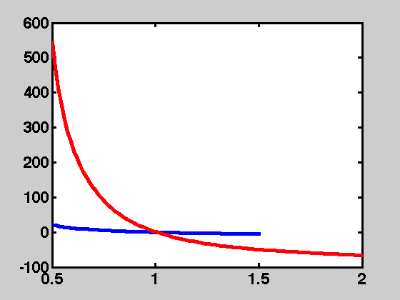
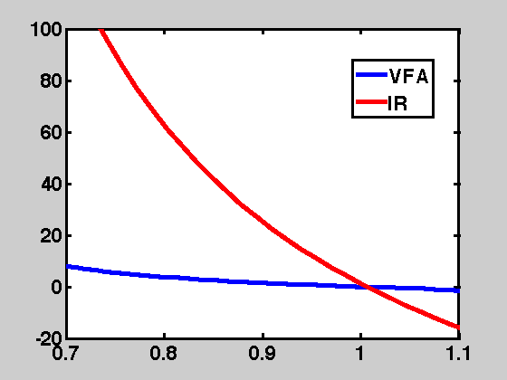
Simulated qMT F % error vs B1 errors using VFA (blue) T1 maps and fixed T1 value (such as IR) (red)
Error % of fitted qMT F
B₁ error

Slide 19
Simulated qMT F % error vs B1 errors using VFA (blue) T1 maps and fixed T1 value (such as IR) (red)
Error % of fitted qMT F
B₁ error

Slide 20
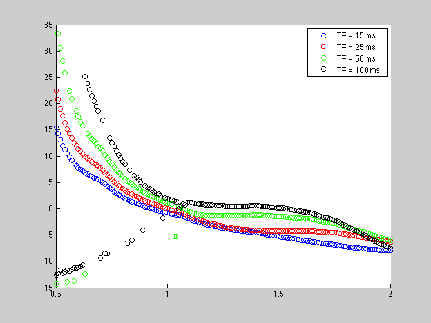
Error % of fitted qMT F

Slide 21
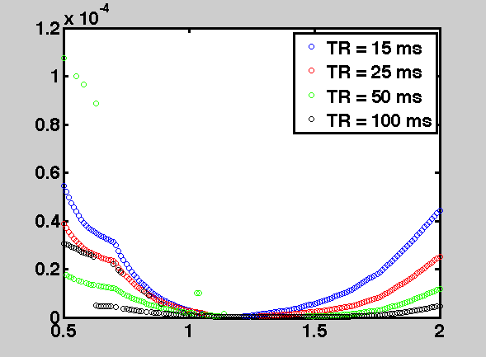
Fit root mean square error

Slide 22
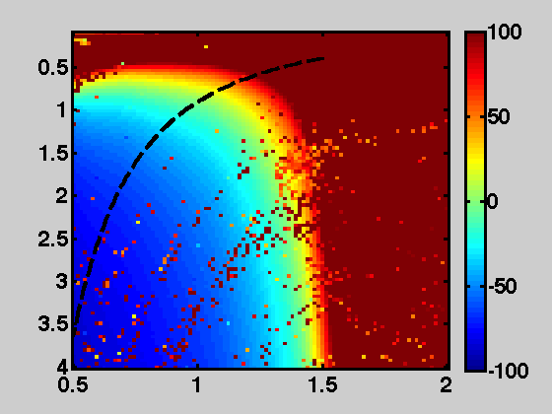
Fitted qMT kf error %
T₁ (s) error (true value 0.9)
B₁ error

Slide 23
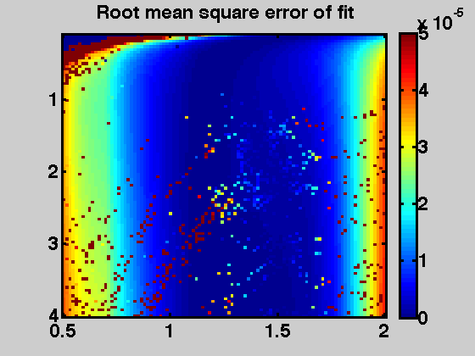
T₁ (s) error (true value 0.9)
B₁ error

Slide 24
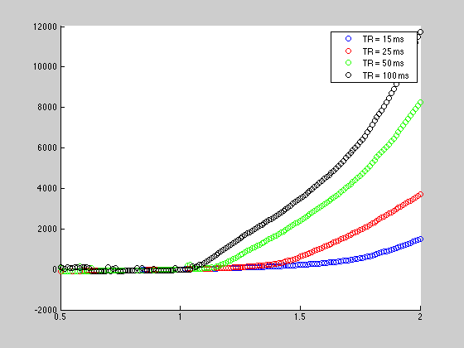
Error % of fitted qMT kf

Slide 25
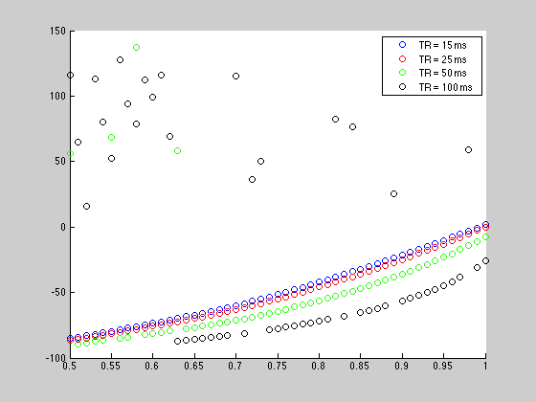
Error % of fitted qMT kf

Slide 26
Noise simulations
Omited

Slide 27
Stage 2: In vivo, Normal Subjects
3 Healthy subjects
Single Slice
T1: IR and VFA
qMT: UK and Opt

Slide 28
B₁ error propogation

Slide 29
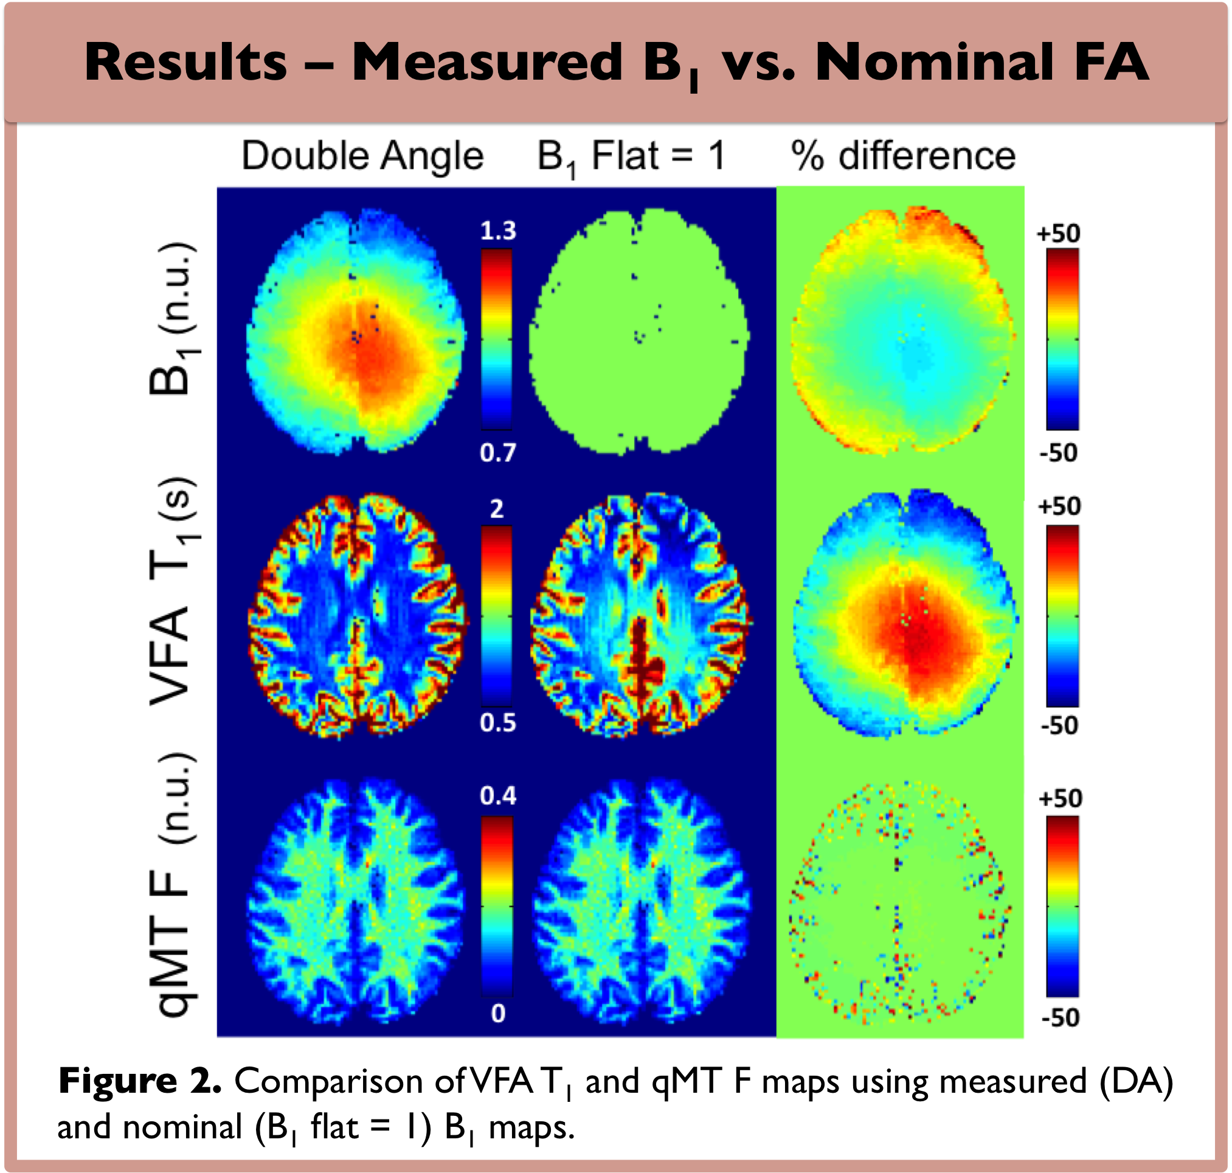
Opt qMT protocol

Slide 30
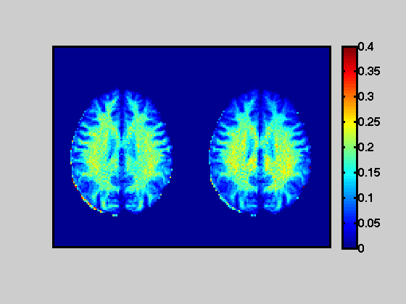
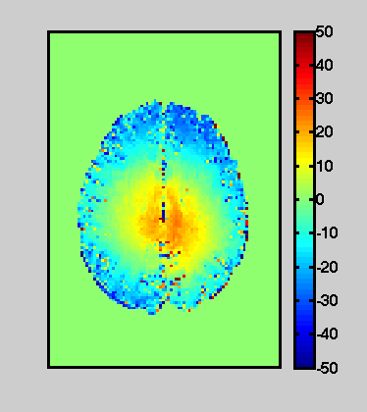
Opt qMT protocol
qMT F map
% Difference
IR+(B1=DA)
IR+(B1=1)

Slide 31
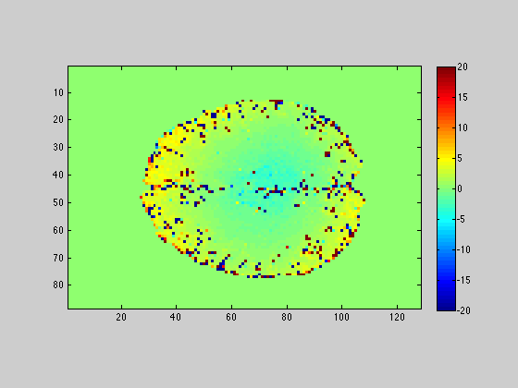
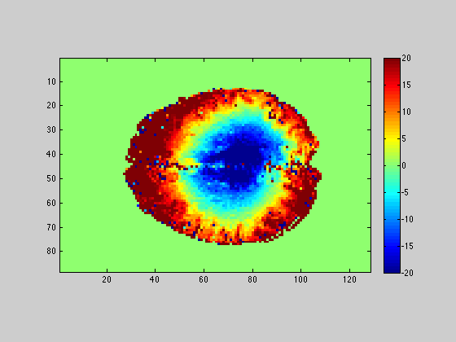
VFA
Error % in qMT F (UK Protocol)
IR
*Scale bar changed from last slides

Slide 32
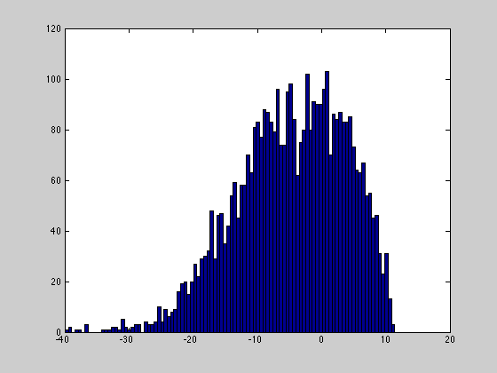
B1 % error in brain (relative to nominal FA, i.e. B1=1)
B1 % error

Slide 33
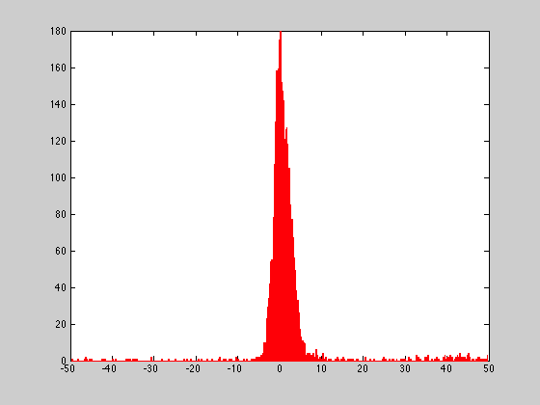
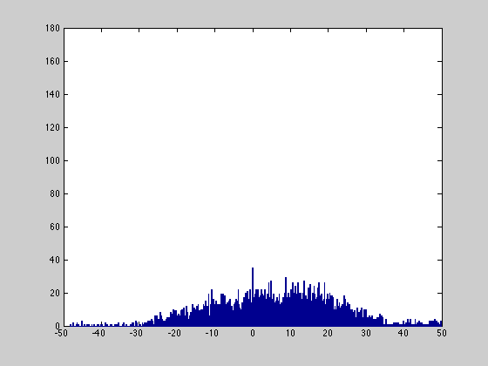
Error % in qMT F between B1=Measured and B1=1 (flat/nominal) (UK Protocol, 1 subject)
Red- VFA
Blue - IR

Slide 34
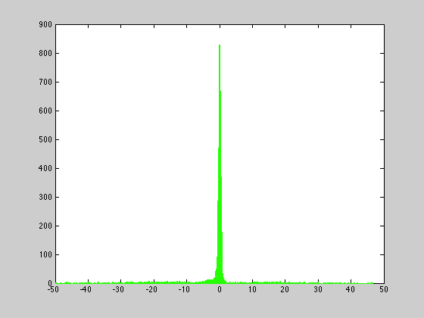
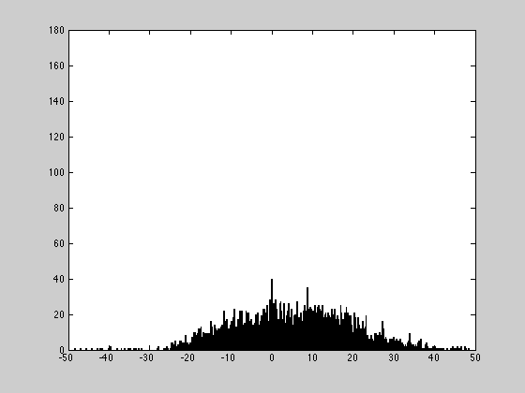
Error % in qMT F between B1=Measured and B1=1 (flat/nominal) (Opt protocol for green and black, 1 subject)
Green- VFA
Black - IR

Slide 35
Error % in qMT F between B1=Measured and B1=1 (flat/nominal) (UK Protocol for red and blue*, 1 subject)
*Green –VFA & Opt 10 pt qMT protocol

Slide 36
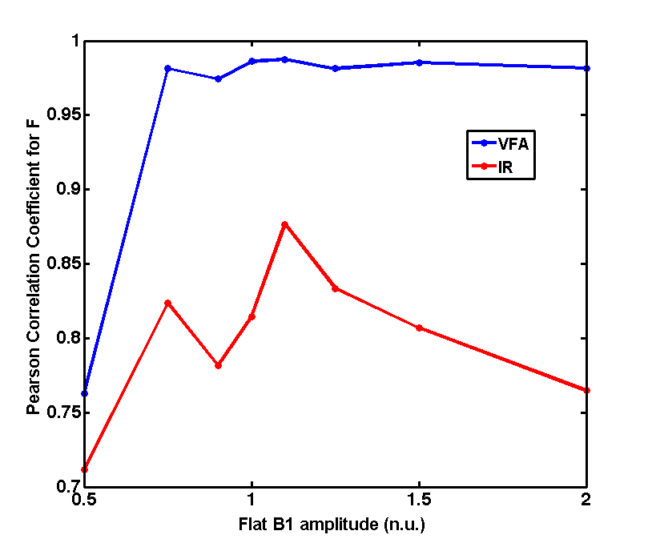
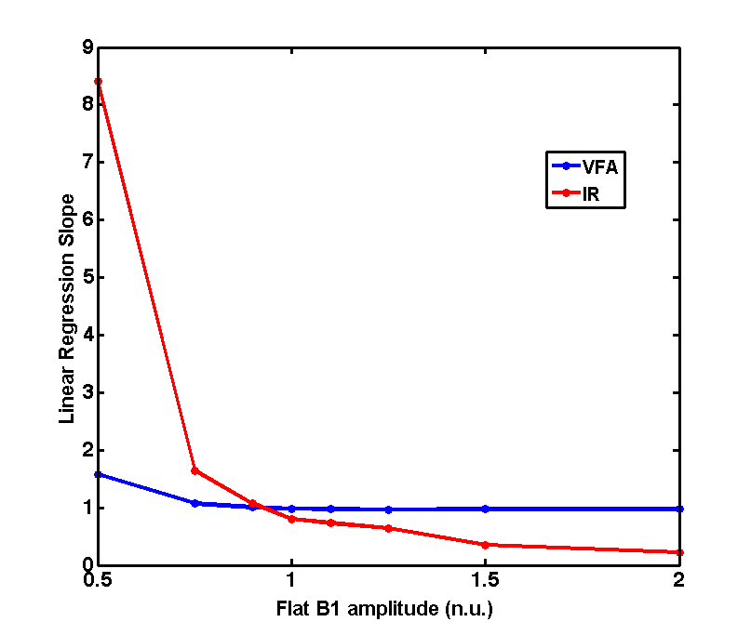
Opt qMT protocol
Figure 3. Linear regression analysis of the voxelwise qMT F parameter, comparing measured DA B₁ and a range of flat B₁ (VFA T₁, blue; IR T₁, red).

Slide 37
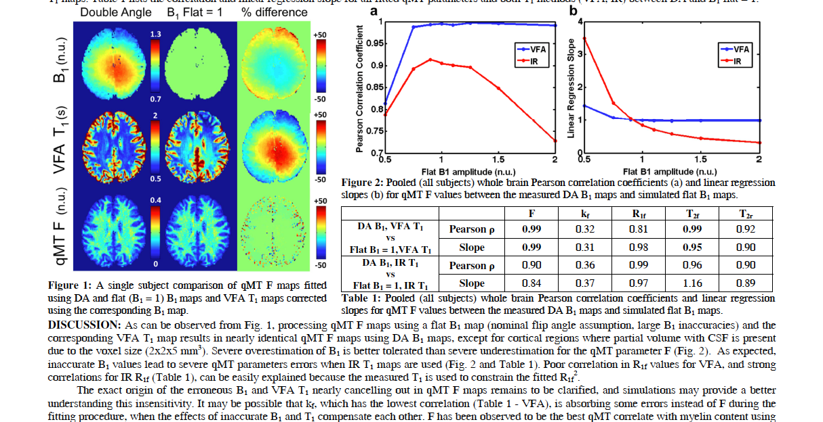
UK qMT protocol
Opt qMT protocol
Simulated WM F % error
In Vivo Whole-Brain F
B₁ error

Slide 38
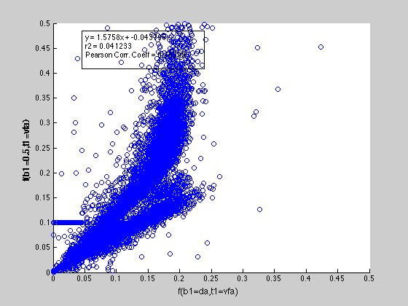
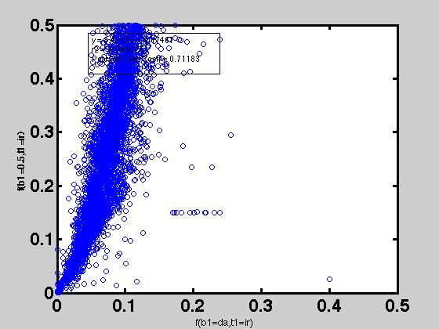
qMT F parameter comparison
B1 measured vs. B1 flat = 0.5
VFA | IR

Slide 39
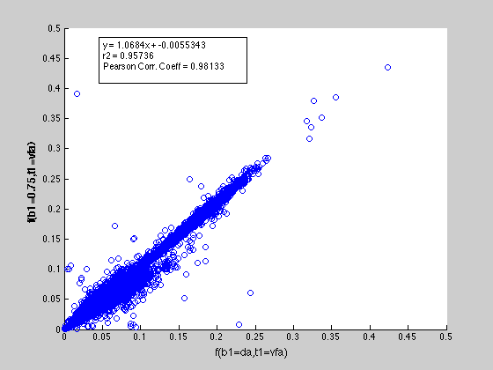
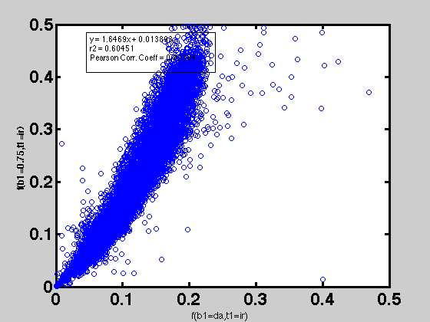
qMT F parameter comparison
B1 measured vs. B1 flat = 0.75
VFA | IR

Slide 40
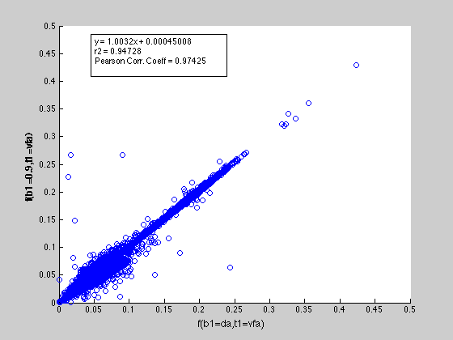
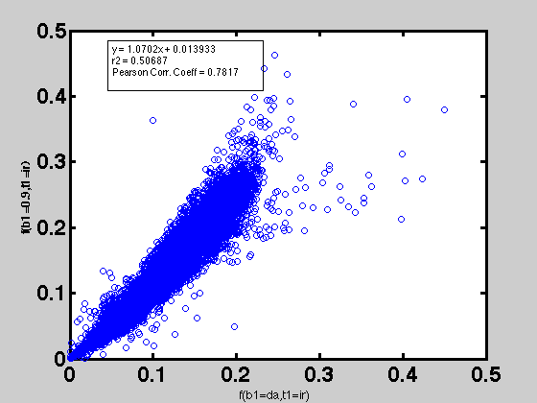
qMT F parameter comparison
B1 measured vs. B1 flat = 0.9
VFA | IR

Slide 41
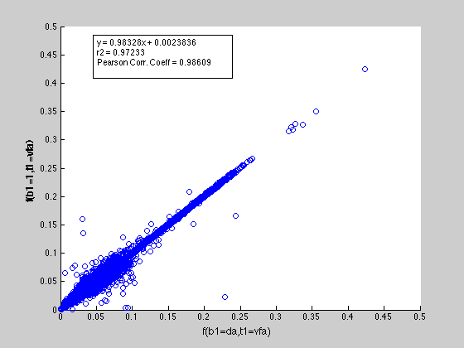
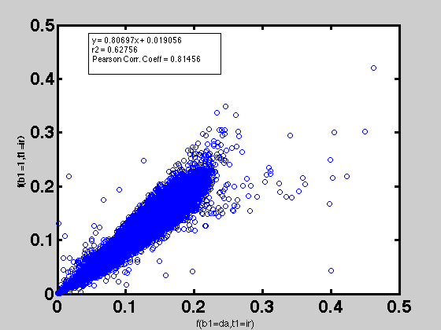
qMT F parameter comparison
B1 measured vs. B1 flat = 1
VFA | IR

Slide 42
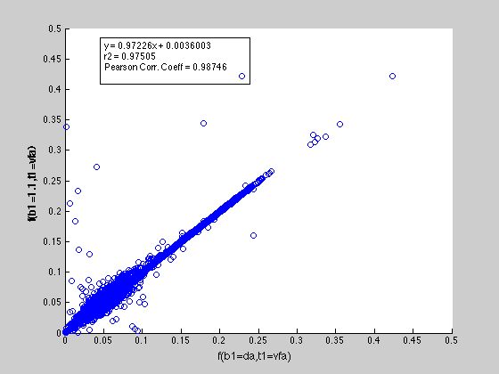
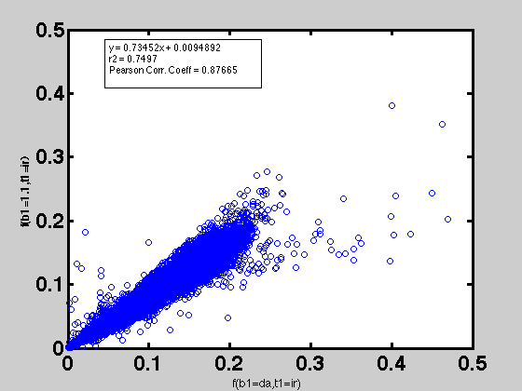
qMT F parameter comparison
B1 measured vs. B1 flat = 1.1
VFA | IR

Slide 43

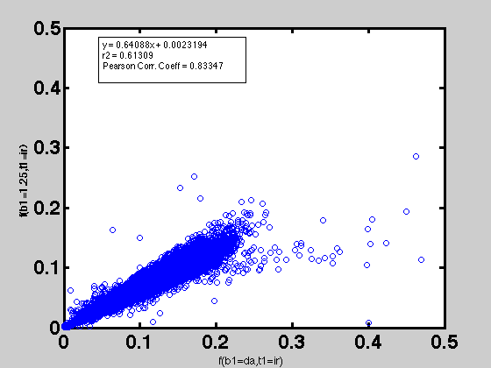
qMT F parameter comparison
B1 measured vs. B1 flat = 1.25
VFA | IR

Slide 44
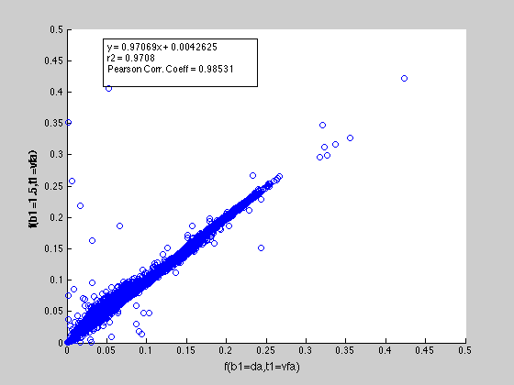
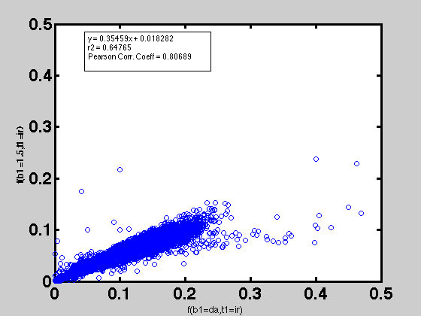
qMT F parameter comparison
B1 measured vs. B1 flat = 1.5
VFA | IR

Slide 45
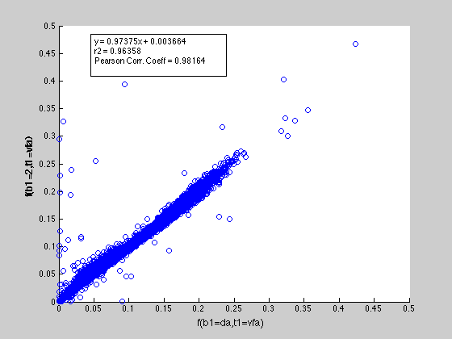

qMT F parameter comparison
B1 measured vs. B1 flat = 2
VFA | IR

Slide 46


Slide 47
Stage 3: MS Patient
3D data already acquired for another study at 3T
Am I allowed to use this data? Which ethics form was used?
To process with B1 flat+lesion masks

Slide 48



Relapse Remitting MS Patient
To do with B1=1 (flat) + lesion masks

Slide 49


Slide 50






